Slide 1

Designing a 16-Bit RISC-V Processor with 8 Instructions Using Vivado

Slide 2
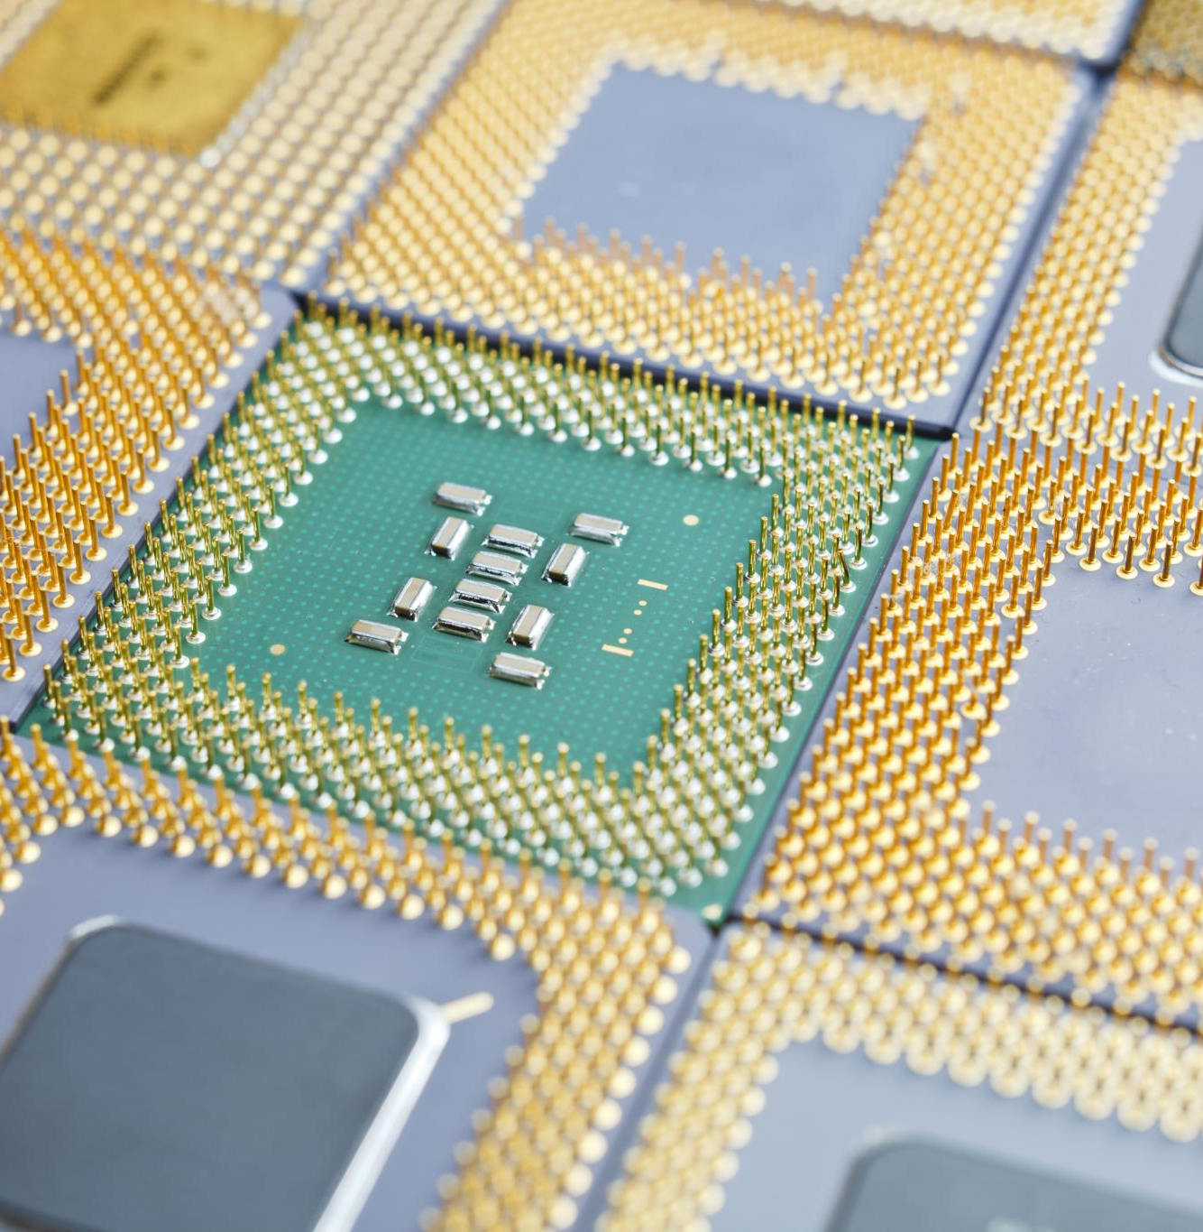
Agenda for Today's Presentation
Introduction to the Project
Processor Architecture and Instruction Set
Instruction Implementation
Simulation
Testing
Conclusion and Future Work

Slide 3





The team
Ilia Panayotov
Esra Mehmedova
Esin Mehmedova
Yiğit İlk
Paul Hagner

Slide 4
Introduction to the Project

Slide 5

Project Objectives and Goals
Design a 16-bit Processor
The project aims to design a functional 16-bit processor capable of executing eight specific instructions, enhancing computational capabilities.
Understanding Digital Design
We aim to deepen our understanding of digital design principles, which are crucial for successful hardware implementation.

Slide 6
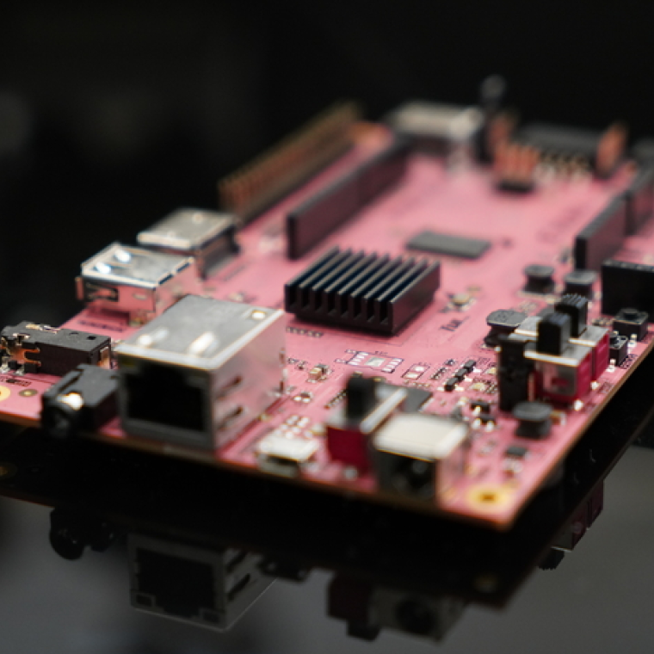
Introduction to the PYNQ-Z2 Board
FPGA Development Board
The PYNQ-Z2 board serves as an FPGA development platform, enabling advanced hardware designs and digital signal processing projects.
Xilinx Zynq-7000 SoC
This board is based on the Xilinx Zynq-7000 System on Chip, integrating programmable logic with an ARM processor for versatile applications.
Custom Processor Design
The combination of programmable logic and ARM processing capabilities allows for custom processor designs tailored to specific applications.

Slide 7
Processor Architecture and Instruction Set

Slide 8
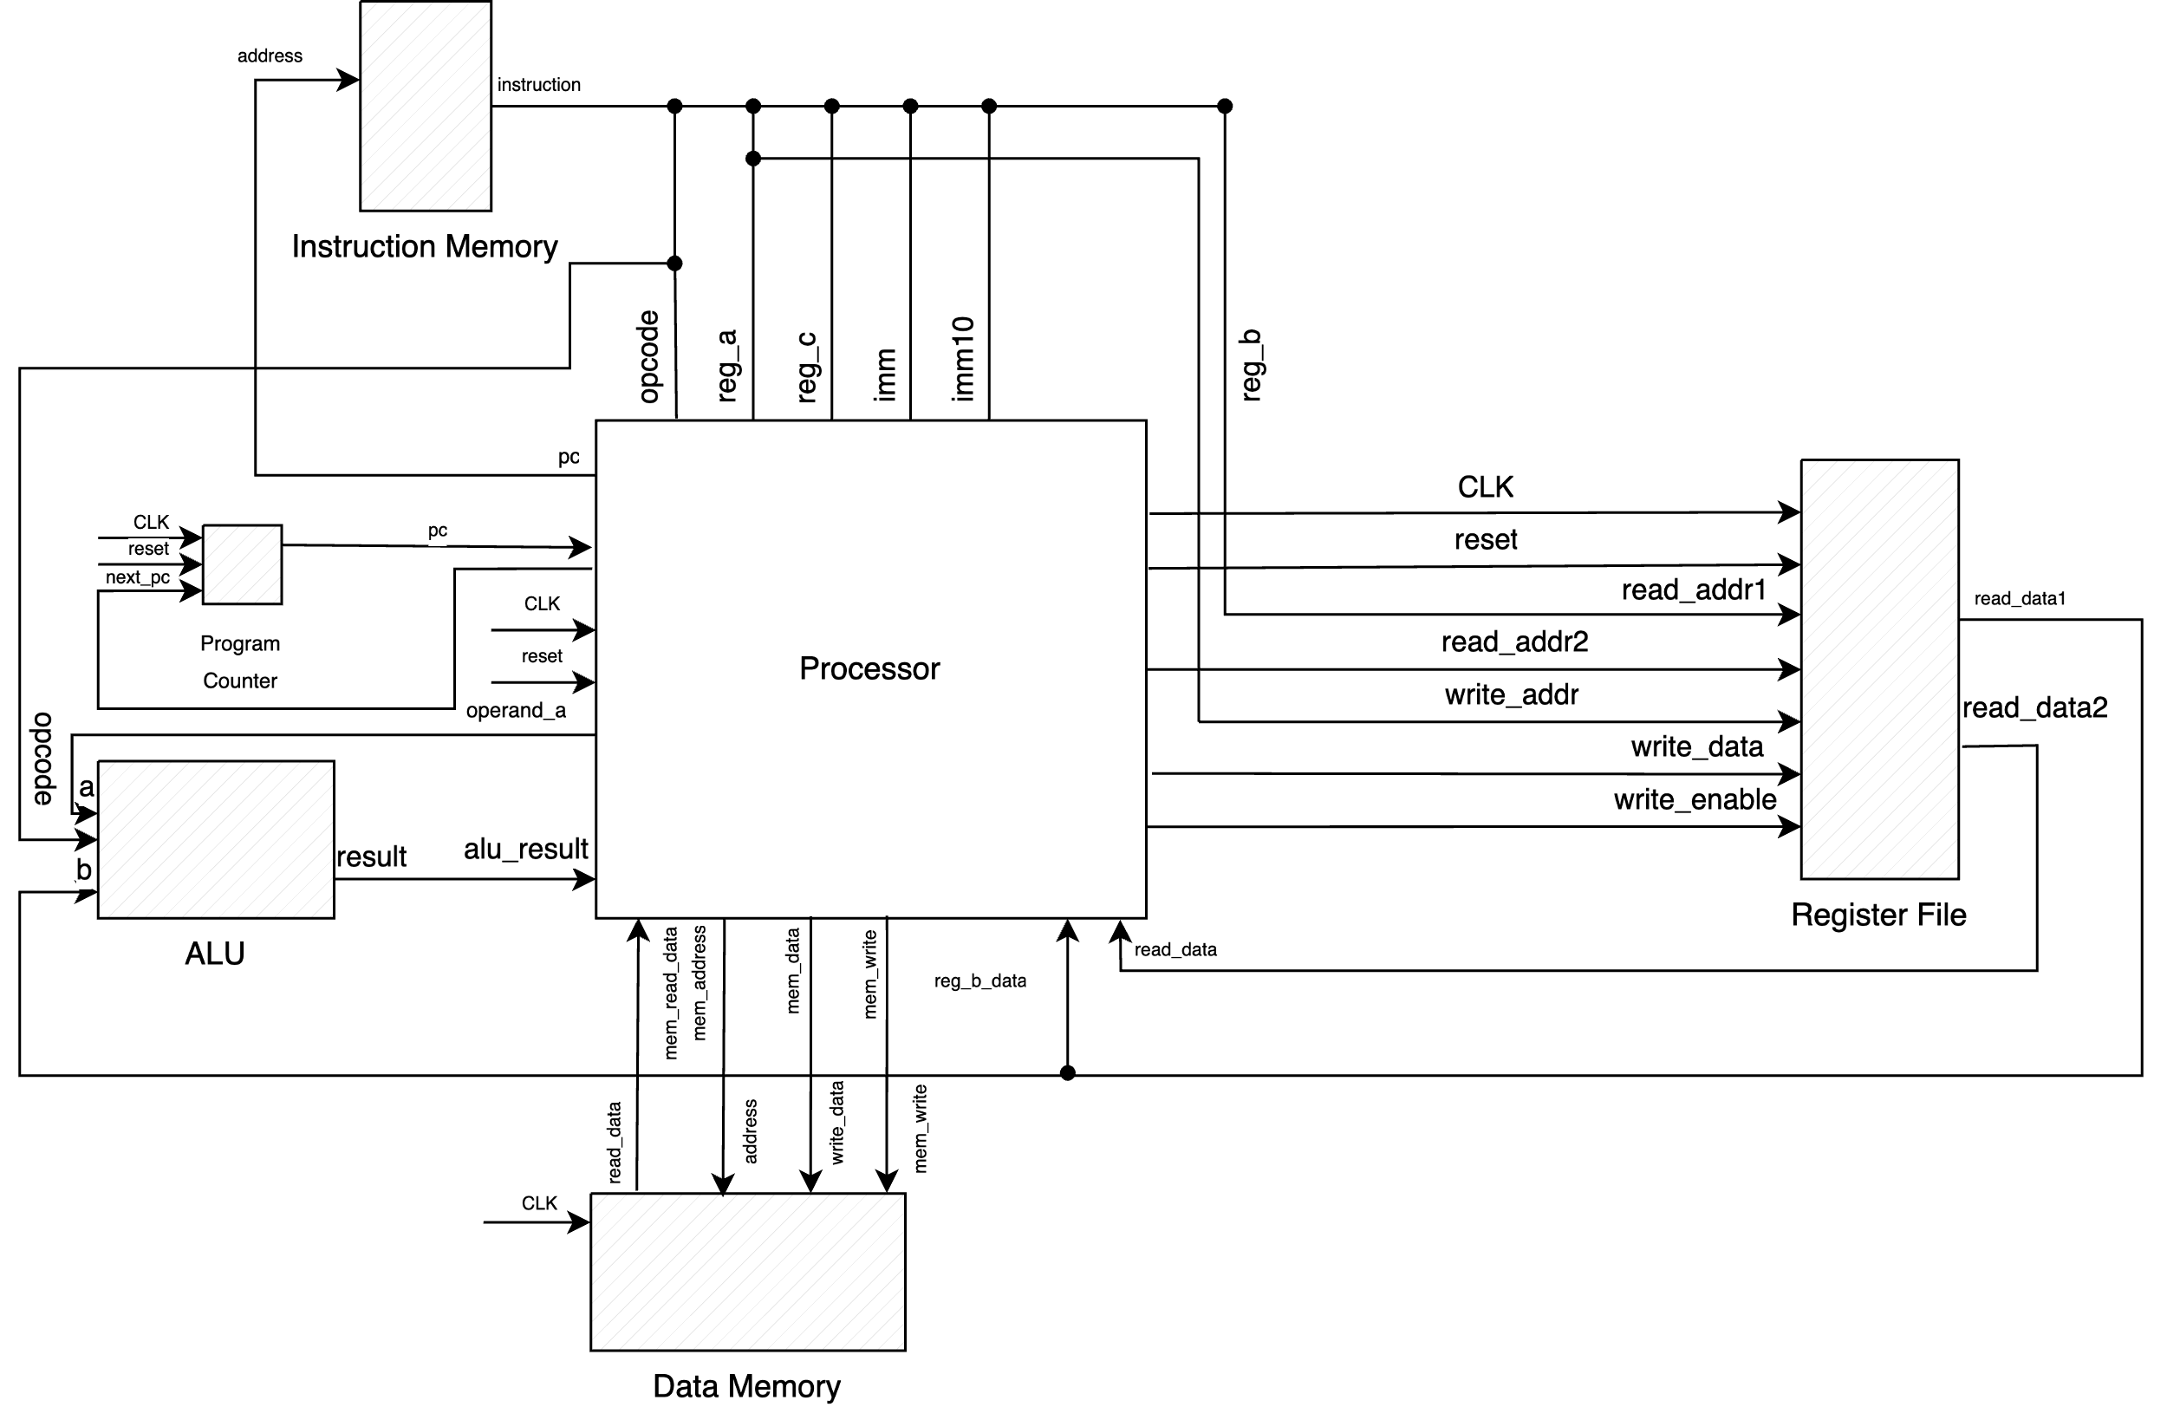
Overview of the 16-Bit Processor Architecture
Register File
Stores temporary data and instructions for quick processor access.
Arithmetic Logic Unit (ALU)
Performs arithmetic operations for instruction execution.
Processor
Directs data flow and manages instruction execution.
Data Memory
Stores and retrieves data needed during execution.
Instruction Memory
Holds program instructions for the processor to execute.

Slide 10
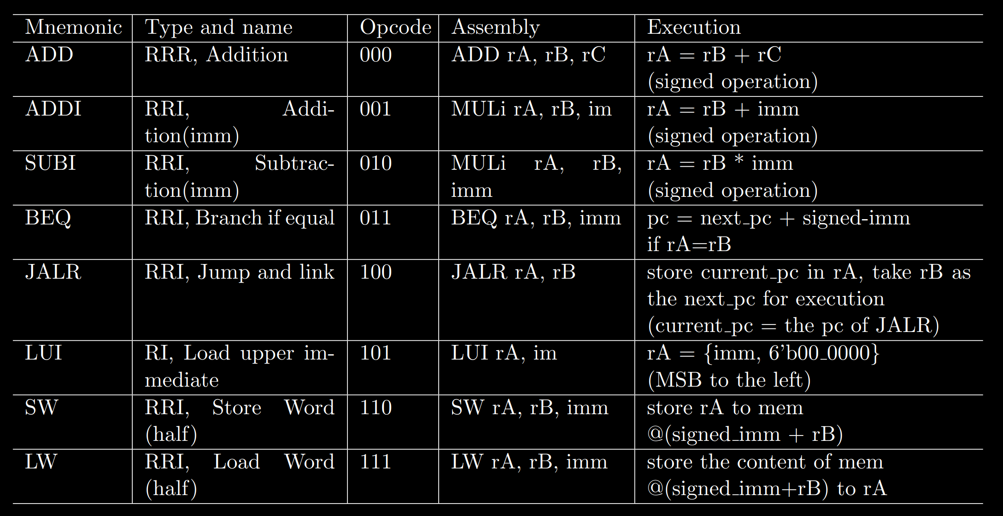
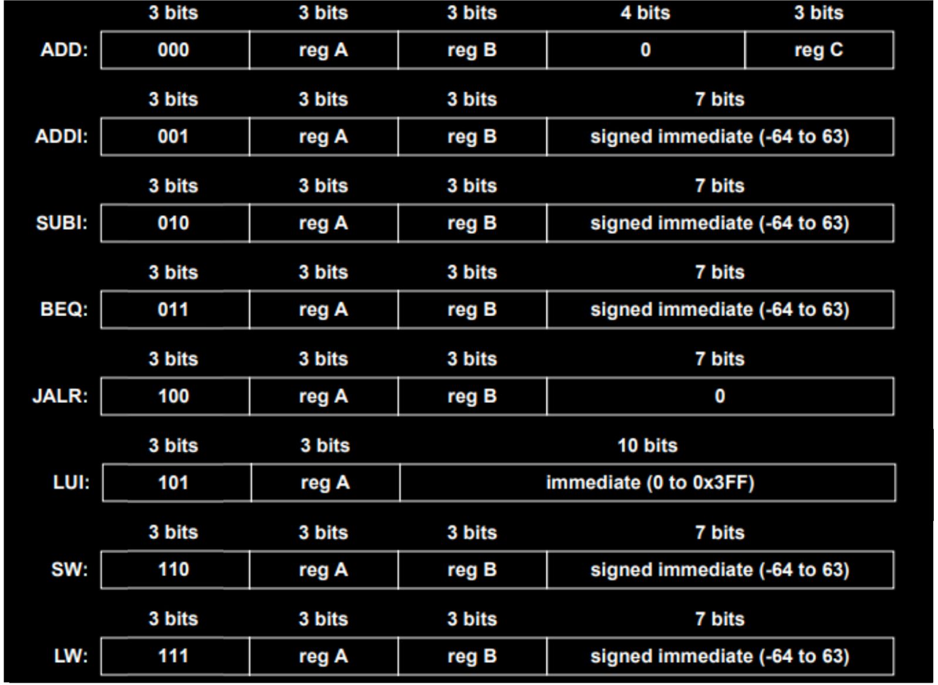
Instruction Set
Custom 16-bit RISC-V instruction set, that includes arithmetic, branching, memory, and immediate value operations

Slide 11
Instruction Implementation

Slide 12
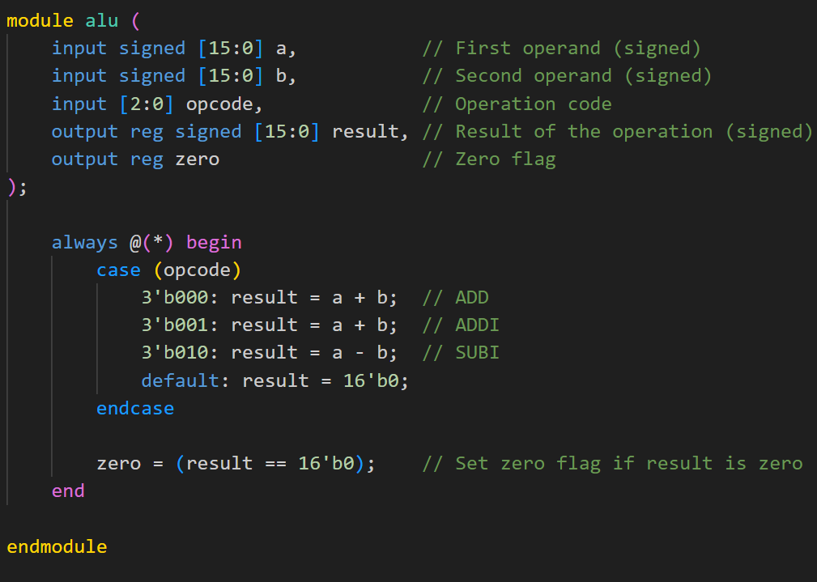
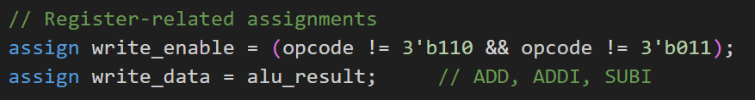
ADD/ADDI/SUBI instructions
Purpose
ADD: reg_a + reg_b = result
ADDI: reg_a + imm = result
SUBI: reg_a – imm = result
Signed Integer Values
Understanding signed integers is crucial, as they can represent both positive and negative values in calculations.
Notes:
The ADD command performs addition on two signed integer values, contained in two registers. The SUBI and ADDI are operations that add/subtract value from the register and a value contained in the instruction.
All of the operands are signed, so they include both positive and negative numbers.

Slide 13
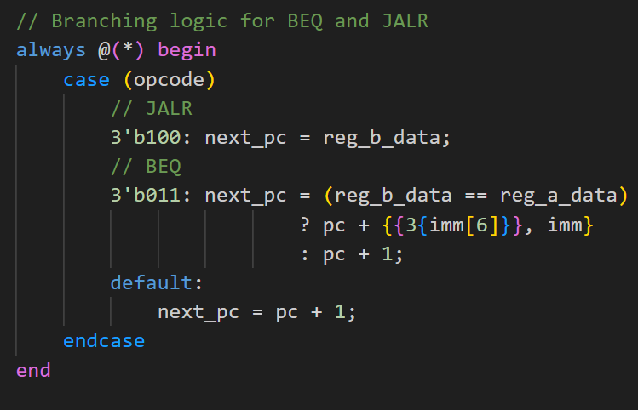
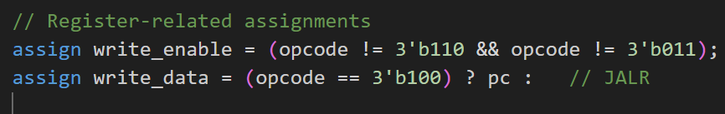
BEQ & JARL
Purpose
Modify the program counter (PC) to alter control flow, enabling conditional or unconditional jumps.
Conditional Branching (BEQ)
Compare reg_a to reg_b
If they are the same: next_pc = pc + imm
If they are different: next_pc = pc + 1
Jump and Link Register (JARL)
Store pc in reg_a
‎next_pc = reg_b

Slide 14
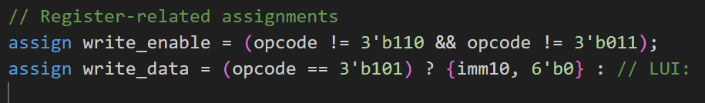
LUI: Load Upper Immediate
Purpose
Manipulate computer registers by setting upper bits to facilitate calculations.
‎Takes a 10-bit immediate value(imm) and shifts it left by 6 bits.
The lower 6 bits are filled with zeros(6’b0).
The result is store in reg_a
This helps in storing large numbers or addresses efficiently.

Slide 15
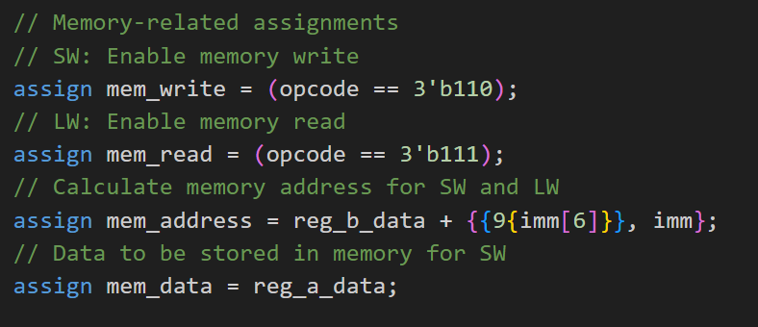
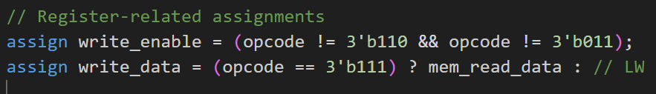
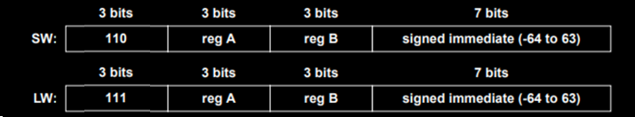
LW & SW
Purpose
The instructions are used to read from and write to memory.
LW: Load Word (Half)
Loads a value from memory into a register.
The memory address is calculated using a base register and an offset.
SW: Store Word (Half)
Stores a register’s value into memory.
The memory address is calculated the same way as in LW.

Slide 16
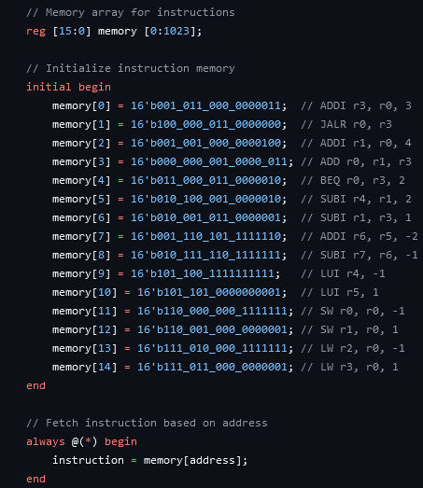
How do we fetch instructions?
Using the PC, we output the respective instruction.
Each instruction is building on the results of the previous operations.

Slide 17
Simulation

Slide 18
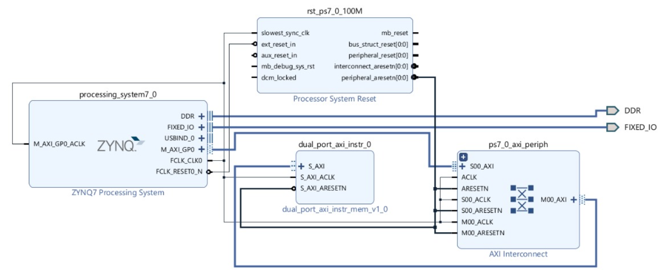
Scheme for the Simulation Environment in Vivado

Slide 19
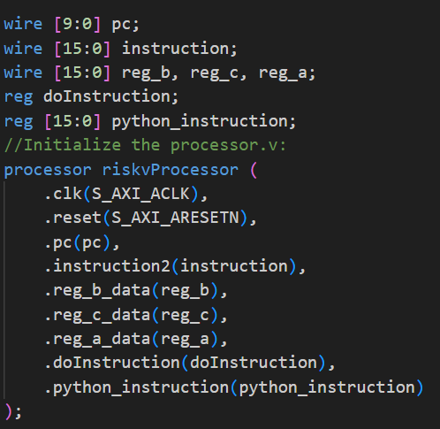
Dual port AXI Instruction memory
The approach to:
Initialize the Verilog processor file
The approach to:
Handle Write Addresses for addressing where in memory of the slave to write to
Hanle Write Data of the data being put into the slave memory.

Slide 20
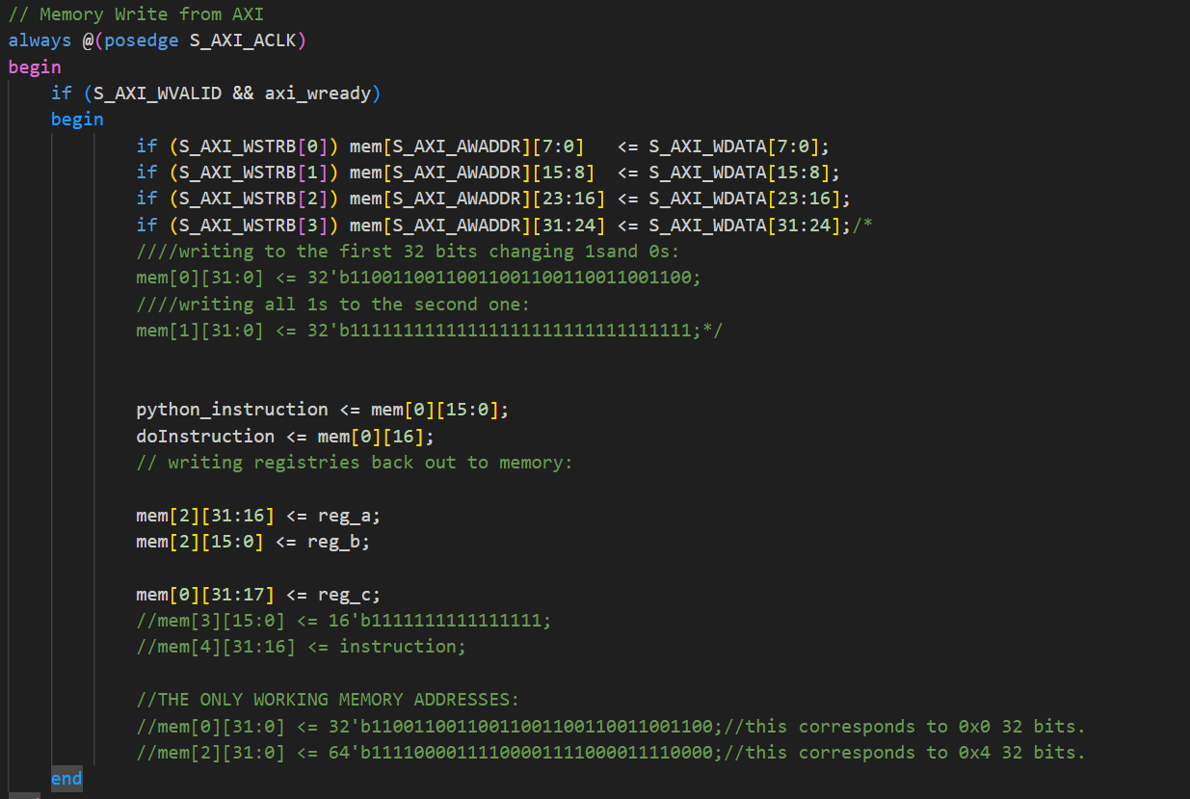
Dual port AXI Instruction memory
We had to bypass the given axi template memory file, which fetches new instructions in the processor. And replace it with instructions fetched by us manually.

Slide 21
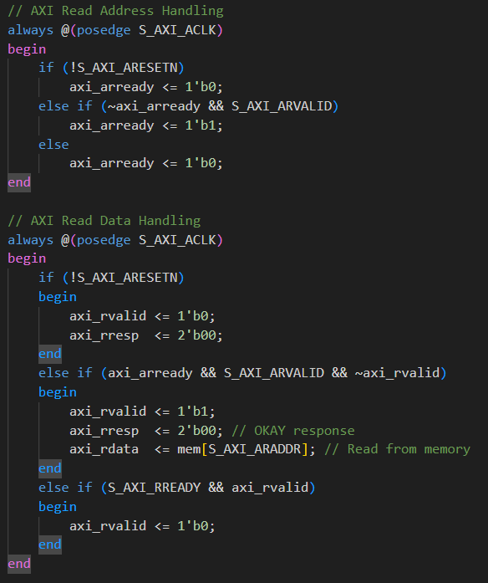
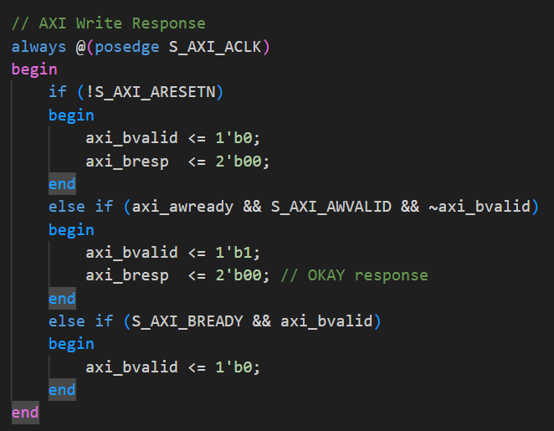
Dual port AXI Instruction memory
In addition, we needed to provide the output to the Python implementation that was executing the processor:
At the end we had to make sure that the result we got from the processor was correct format:

Slide 22
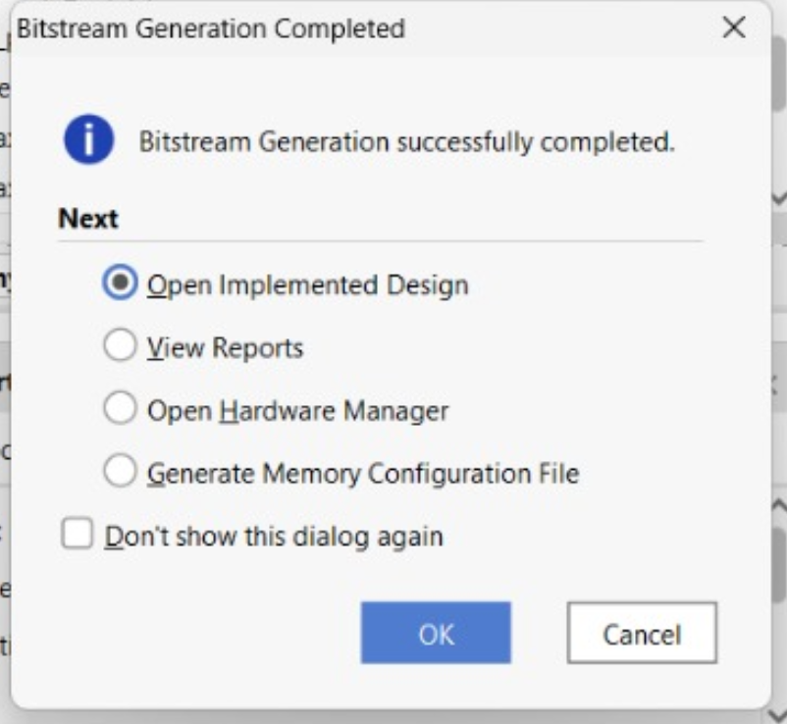
Testing and Validating the Processor on Hardware
Before testing the operations on the hardware we need to generate the bit file.
To create the bit file we are using Vivado.
After creation of the file we get such notification in Vivado and we are ready to test.

Slide 23
Testing

Slide 24
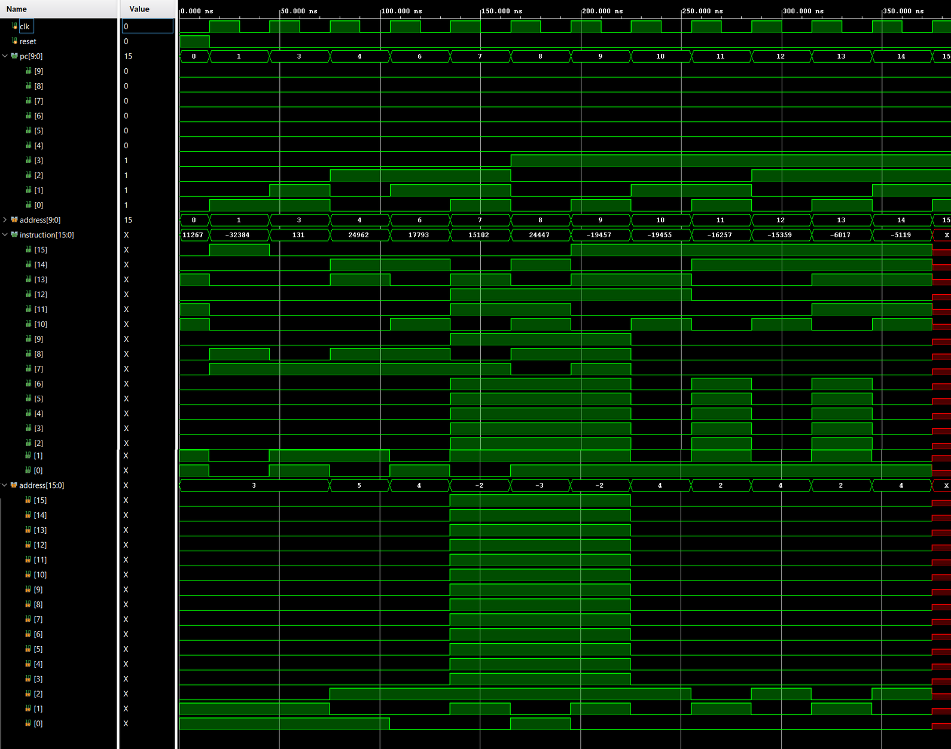
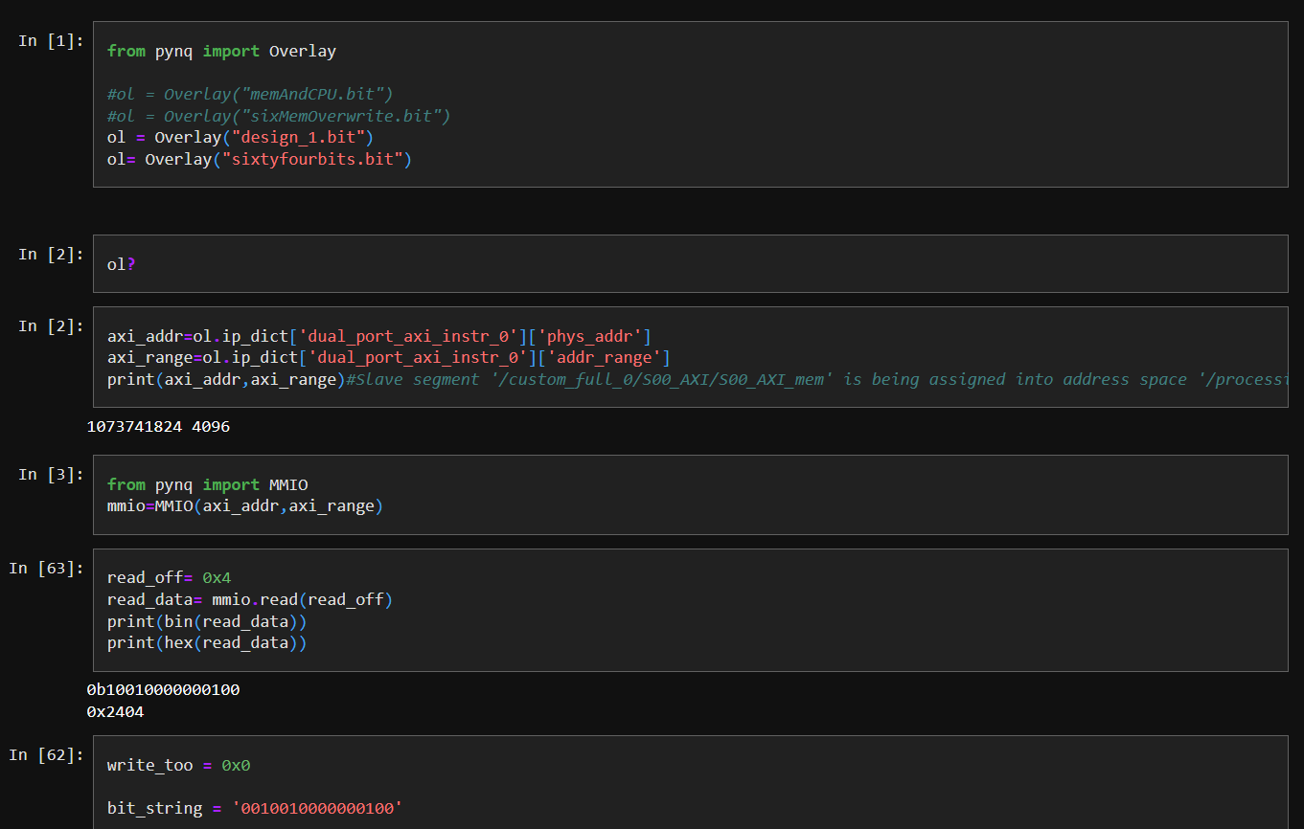
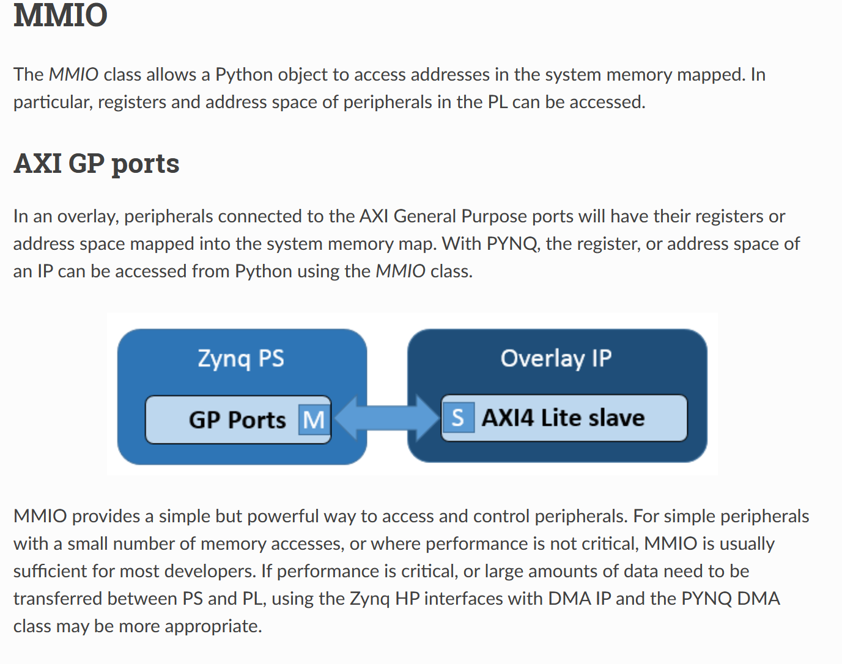
Using Waveforms and integrated programme counter for tests
Testing if it all actually works
We can simply just create iverilog signal waveforms to actually test if everything is working thanks to our programme counter, but if we want to take it to the next level, we need actual access to the FPGA running our bit file.

Slide 25
Using Waveforms and integrated programme counter for tests
Here on the left, you can see our integrated testing with the programme counter actually working with all of the functions.

Slide 26
Using Python and Pynq library to conduct real life tests
Here, we have the mmio class integrated into our PYNQ Z2 board's Python interface.

Slide 27
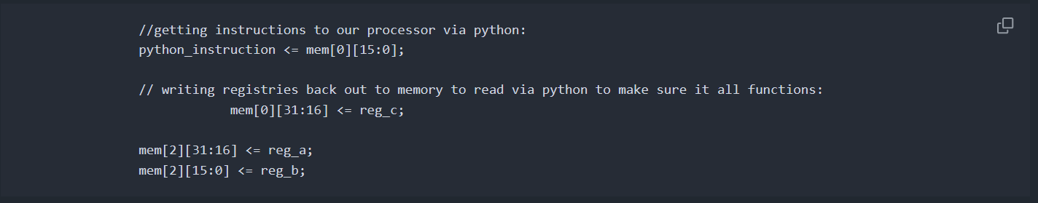
Using Python and Pynq library to conduct real life tests
Here, we have the mmio class integrated into our PYNQ Z2 board's Python interface.

Slide 28
Using Python and Pynq library to conduct real life tests
The Overlay IP we created for our setup with the AXI can be communicated through the Python code allowing us to read portions of the memory.
But unfortunately it only allows us to read and write only 2*32 bits.

Slide 29
Conclusion and Future Work

Slide 30

Challenges Faced and Solutions Implemented
Encountered Challenges
The project faced several challenges, including bugs in the code and issues with integration.
Debugging Techniques
We implemented various debugging techniques to identify and resolve coding issues effectively and efficiently. Testing various inputs of 16-bit numbers and comparing them to the output

Slide 31
Potential Improvements and Future Work
Enhancing Processor Design
Future improvements can focus on enhancing processor design by implementing a simpler processor file and creating a control unit.
Making it fully function on the Pinq board
Optimizing the code for input of the instructions and output, so it is functioning with the Verilog we created for the brains of the project.
Exploring New Features
Exploring additional features like interrupts and advanced memory management can significantly enhance processor capabilities.

